Slide 1

Sentimental analysis
Categorizing Sentimental score
Based on the existing sentimental score, a separate column was created.
-1 → Disastrous
+1→ Masterpiece
  Advanced Sentiment Analysis
  "JMP Pro 17 was utilized for analyzing sentiment values."
  Identify word-level sentiment impact.
Notes:
Now, let me give you an overview of sentiment analysis."
"For sentiment values ranging from -1 to +1, we assigned descriptive text categories—ranging from Terrible to Masterpiece. You might be wondering how we got those values."
"Some of you may already know about JMP software. For those who don’t, it’s an advanced statistical analysis tool that allows us to process and analyze sentiment data from a variety of sources—customer responses, reviews, feedback, you name it."

Slide 2
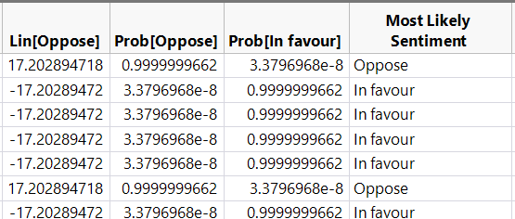
Building a Predictive Model
Analyzed frequently used words to understand their influence on sentiment.
Created a logistic regression model using 100 randomly selected movies.
Classified sentiment into two categories:
  In Favor: Positive emotional.
  Opposed: Negative emotional.
Title | words
Inception | philosophy skilled kidnapping manipulation mission person "target s subconscious" implantation rescue infiltrating corporate espionage life architecture thief chance cobb impossible task dream payment inception spy considered heist California regain old subconscious France Paris idea target offered "person idea" allegory airplane memory virtual reality car crash los Angeles commits targets world

Slide 3
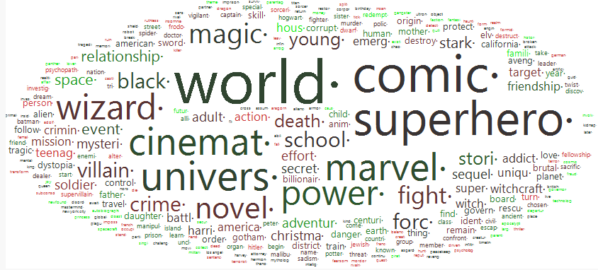
Analyzing sentiment values
A dataset of 100 randomly selected movies was fed into the software (JMP Pro 17) for analysis.
Used the Text Explorer feature to identify the most frequently used words

Slide 4
Insights from Analysis
Title | Year | Rating | Sentiment
12 Angry Men | 1957 | 9 | Bad
Fight Club | 1999 | 8.8 | Disappointing
Inception | 2010 | 8.8 | Bad
Inglourious Basterds | 2009 | 8.3 | Disappointing
It | 2017 | 8.1 | Disappointing
Joker | 2019 | 8.5 | Disappointing
Kill Bill: Vol. 1 | 2003 | 8.1 | Terrible
Memento | 2000 | 8.4 | Bad
Pirates of the Caribbean: At World's End | 2007 | 8.2 | Bad
Prisoners | 2013 | 8.1 | Bad
Saving Private Ryan | 1998 | 8.6 | Disappointing
Se7en | 1995 | 8.6 | Bad
Shutter Island | 2010 | 8.2 | Terrible
The Godfather | 1972 | 9.2 | Disappointing
The Pianist | 2002 | 8.5 | Bad
The Prestige | 2006 | 8.5 | Bad
Best-rated movies often had low sentiment scores, meaning high ratings don’t always indicate positive emotional responses.
Low-rated movies showed higher sentiment scores, suggesting they could still evoke positive emotional engagement despite low overall ratings.

Slide 5
Emotional vs Rating
Title | Year | Rating | Sentiment
Spider-Man: Far From Home | 2019 | 6.7 | Enjoyable
Ready Player One | 2018 | 6.8 | Mildly Entertaining
Top Gun | 1986 | 5.7 | Enjoyable
Luca | 2021 | 6.3 | Enjoyable
The Terminal | 2004 | 6.8 | Enjoyable
Cars 2 | 2011 | 6.3 | Enjoyable
300: Rise of an Empire | 2014 | 6.9 | Mildly Entertaining
Kung Fu Panda 3 | 2016 | 6.2 | Mildly Entertaining
Cars 3 | 2017 | 5.3 | Mildly Entertaining
Five Feet Apart | 2019 | 6.3 | Enjoyable
Some low-rated movies displayed strong positive sentiment, indicating emotional connections that high ratings don’t always capture.
Conversely, high-rated movies often lacked strong sentiment, possibly due to expectations, critic bias, or other external factors beyond emotional engagement.

